Slide 1
Unbreakable

Slide 2
Unbreakable
Craftsmanship

Slide 3
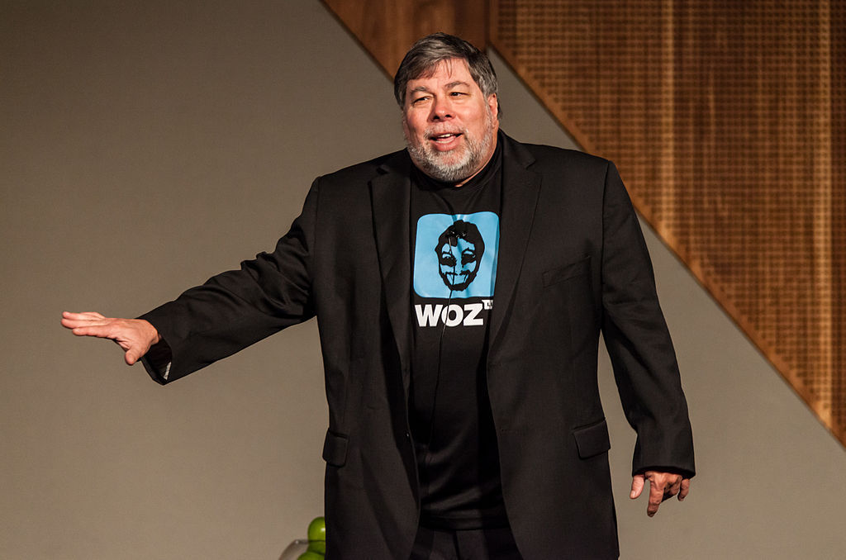

Slide 4
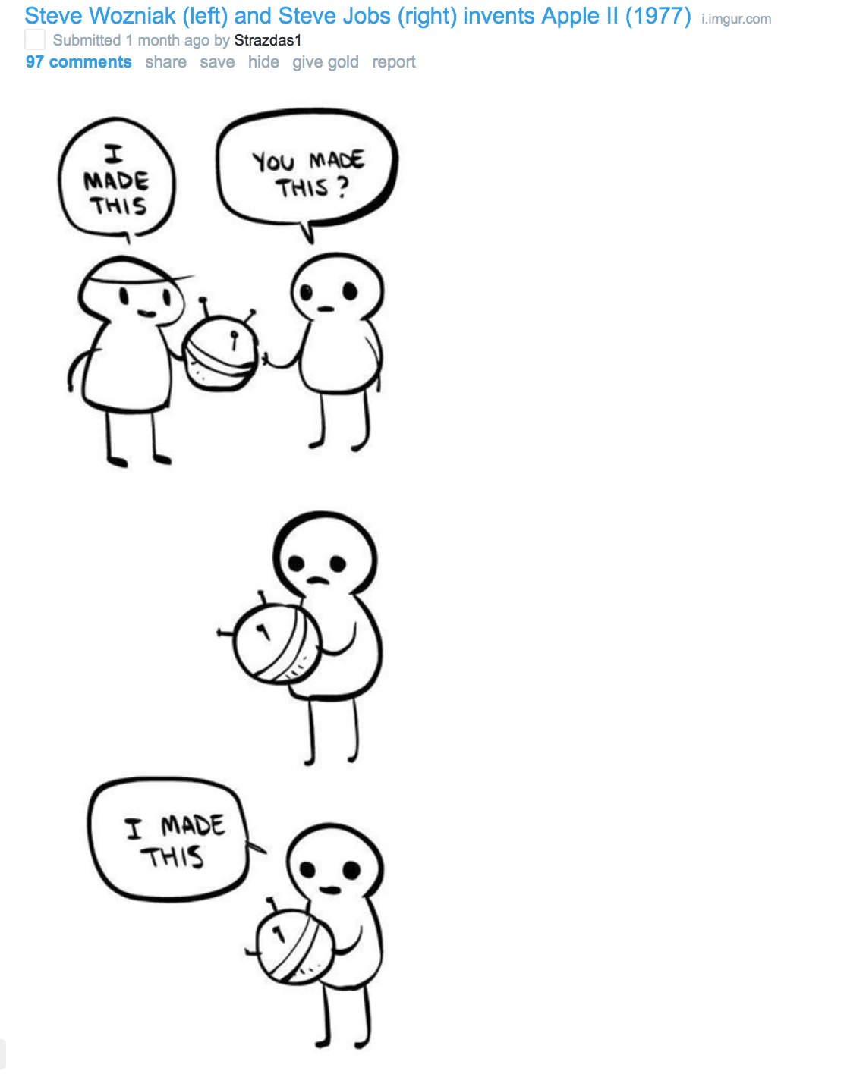

Slide 5
“Woz designed all the hardware and all the circuit boards and all the software that went into the Apple II… not one bug has ever been found … the circuit design of the Apple II is widely considered to be astonishingly beautiful, as close to perfection as one can get in engineering.”
-- Vikram Chandra Geek Sublime

Slide 6
Unbreakable

Slide 7
Unbreakable
Craftsmanship

Slide 8
Unbreakable
Craftsmanship
Doing something good for its own sake

Slide 9
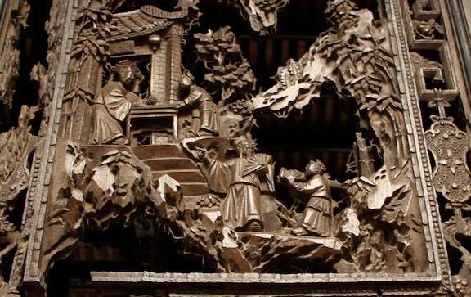

Slide 10
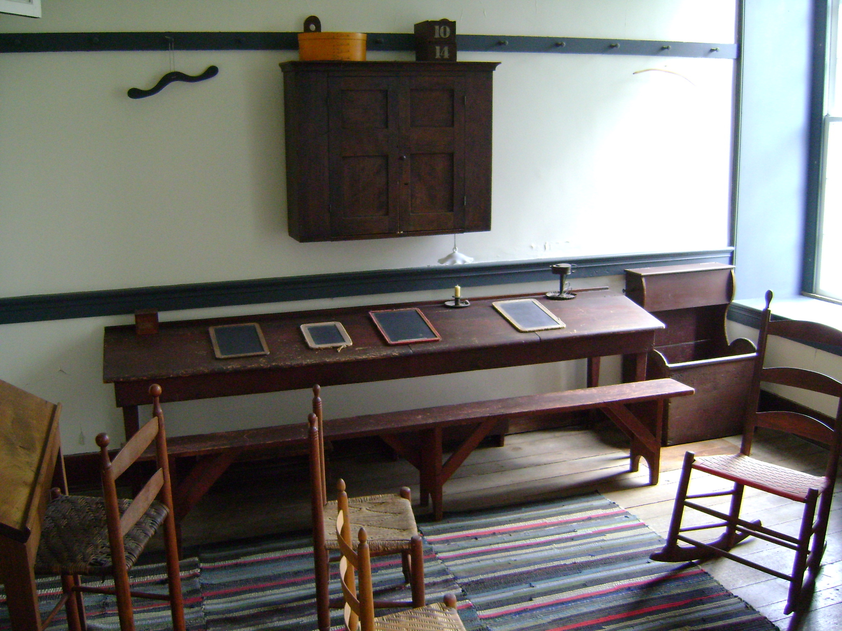

Slide 11
Woz Flow Chart:

Slide 12
Woz Flow Chart:
Be A Genius
Build Stuff

Slide 13


Slide 14
Woz Flow Chart:
Build
Build
Build
Build
Build
Build
Learn
Learn
Learn
Learn
Learn
Build
Learn
Learn
Learn
Build
Build
Build
Build
Build
Learn
Build
Learn
Learn
Learn
Learn
Build
Learn
Build
Learn
Learn
Build
Learn
Learn
Build
Build
Build
Build
Learn
Learn
Learn
Build
Build
Learn
Learn
Learn
Learn
Build
Build
Build
Be A Genius
Learn
Build
Learn
Build
Learn
Learn
Build
Build
Learn
Build
Learn
Build
Learn
Build
Build
Build Stuff

Slide 15
Joe Morgan

Slide 16
Joe Morgan
@joesmorgan

Slide 17
Joe Morgan
@joesmorgan
Lawrence, KS

Slide 18
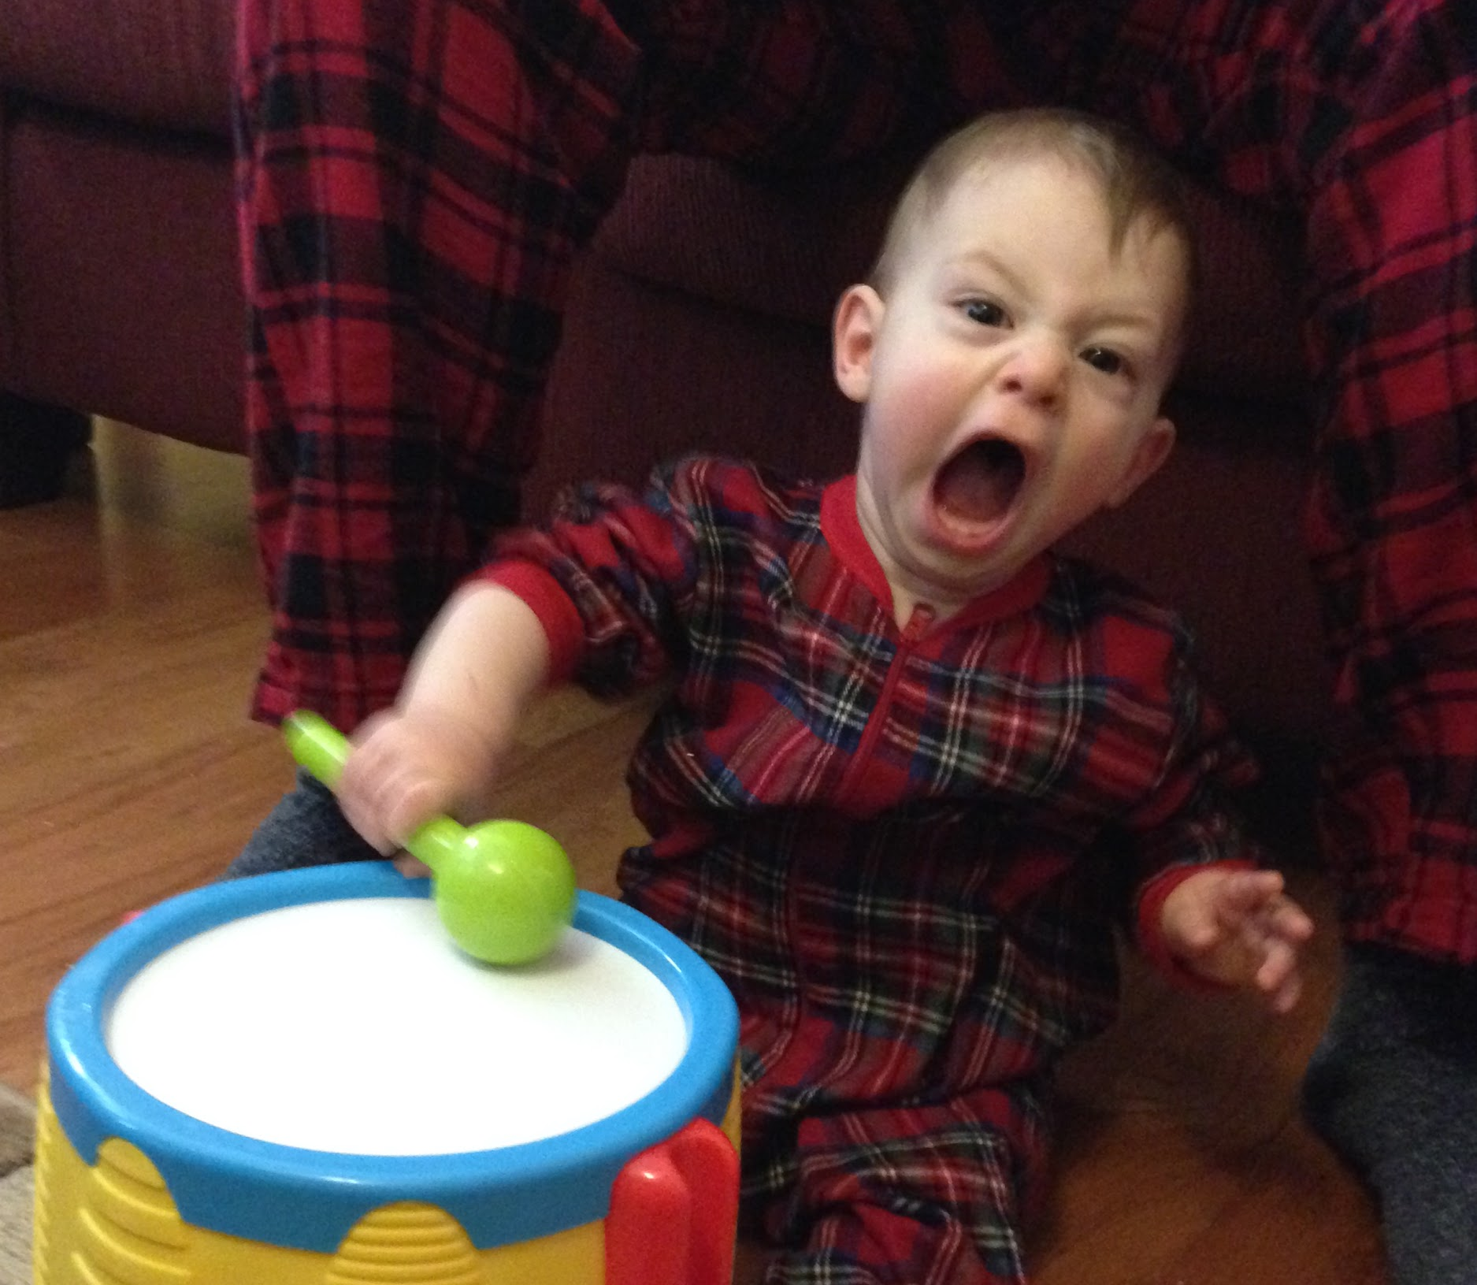

Slide 19
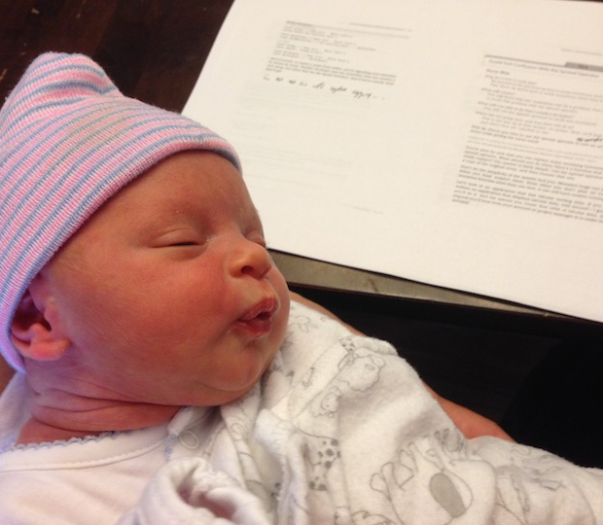

Slide 20
I write code

Slide 21
I write code
I try to get a little better everyday

Slide 22
Stages on craftsmanship

Slide 23

Apprentice

Slide 24
Apprentice

Slide 25
Apprentice: Guidance

Slide 26

Journeymen

Slide 27
Journeymen: Experience and Intuition

Slide 28

Master

Slide 29
Master: Creativity

Slide 30
How does that relate to software?

Slide 31
# of Devs

Slide 34
It works!

Slide 36
$$

Slide 38
Love

Slide 39
Self Evaluation

Slide 40
Servers
Server Code
Frontend Code

Slide 41
Servers
Server Code
Frontend Code

Slide 42
Servers
Server Code
Frontend Code

Slide 43
Servers
Server Code
Frontend Code

Slide 44
Server
Dev Ops
AWS
SQL DB
NoSQL
Functional
OO
Angular

Slide 45
Server
Dev Ops
AWS
SQL DB
NoSQL
Functional
OO
Angular

Slide 46
Server
Dev Ops
AWS
SQL DB
NoSQL
Functional
OO
Angular

Slide 47
Server
Dev Ops
AWS
SQL DB
NoSQL
Functional
OO
Angular 2

Slide 48
How do we improve?

Slide 49

Eye: What can you see?

Slide 50

Eye: What can you see?
Hand: What can you build?

Slide 51

Eye: What can you see?
Hand: What can you build?
Mind: What do you know?

Slide 53
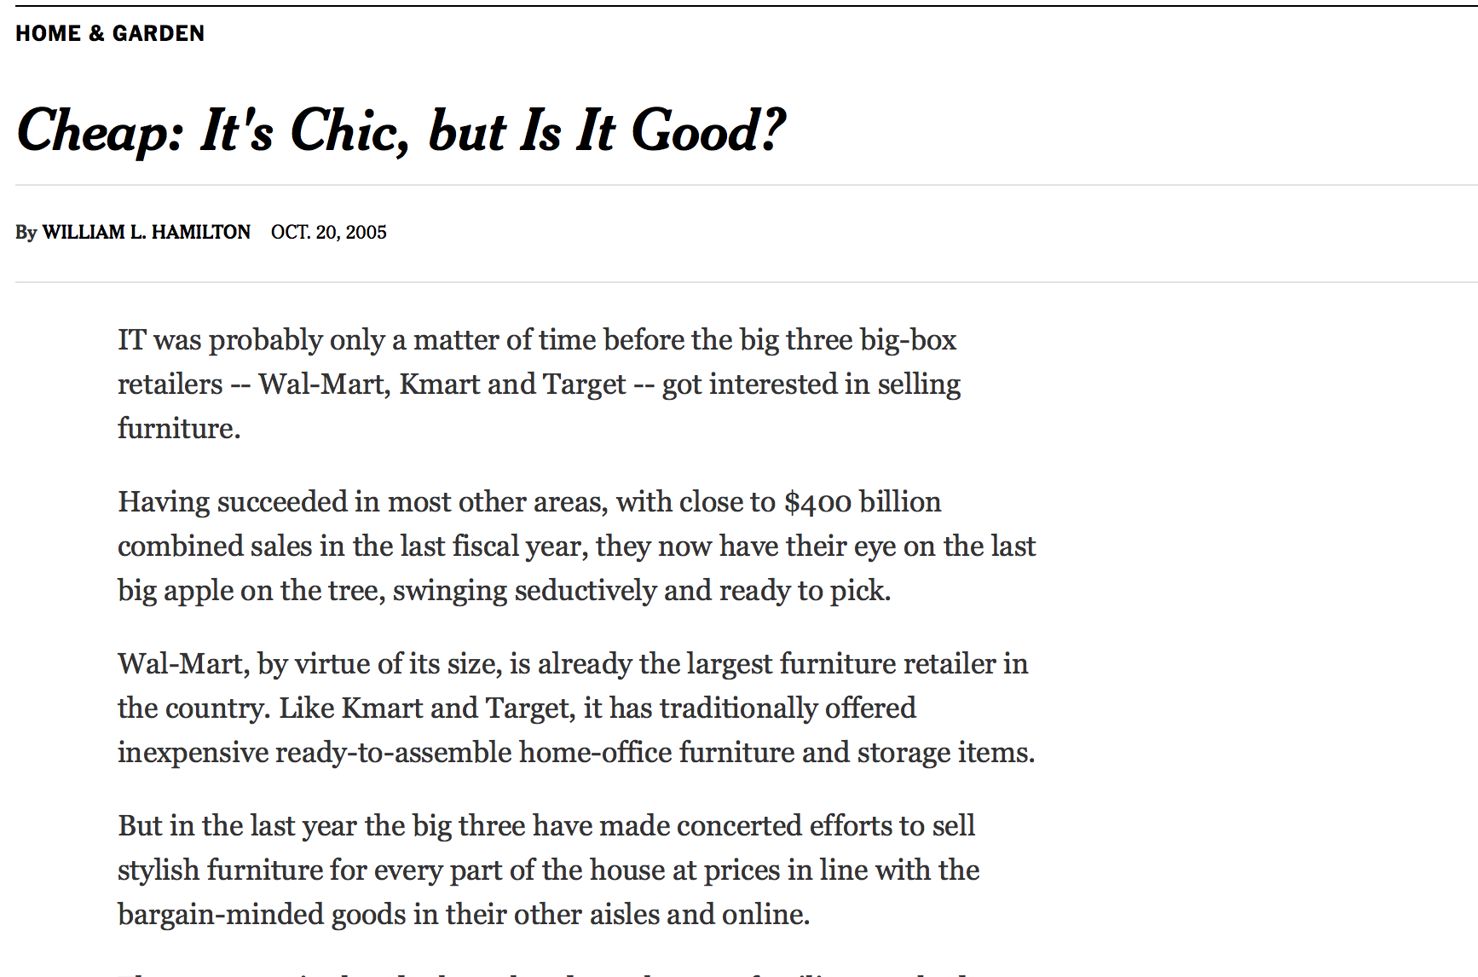

Slide 54
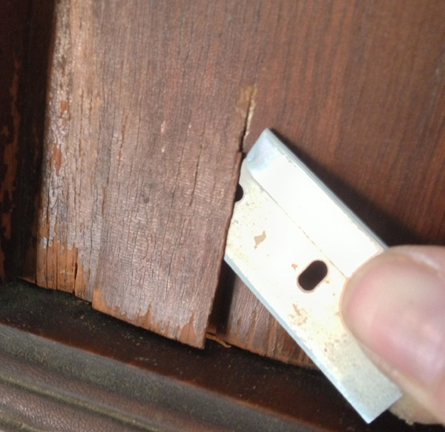

Slide 55
[The chipping paint] could be an example of machine-cutting "without sharp blades," adding "it looks like they painted before they actually cut the piece."

Slide 56
[The chipping paint] could be an example of machine-cutting "without sharp blades," adding "it looks like they painted before they actually cut the piece."

Slide 57
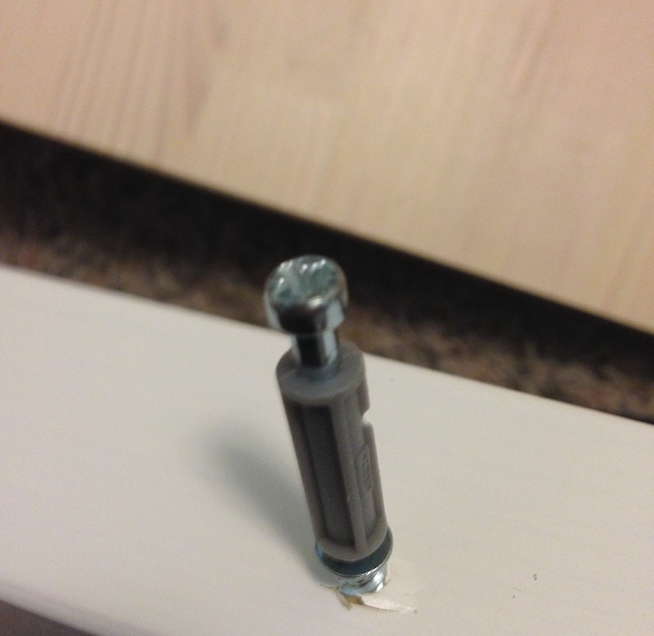

Slide 59
[The chipping paint] could be an example of machine-cutting "without sharp blades," adding "it looks like they painted before they actually cut the piece."

Slide 60
$offset = $argv[0];
$query = "SELECT id, name FROM products ORDER BY name LIMIT 20
OFFSET $offset;";

Slide 61
“Woz designed all the hardware and all the circuit boards and all the software that went into the Appie II… not one bug has ever been found … the circuit design of the Apple II is widely considered to be astonishingly beautiful, as close to perfection as one can get in engineering.”
-- Vikram Chandra Geek Sublime

Slide 62
“Woz designed all the hardware and all the circuit boards and all the software that went into the Apple II… not one bug has ever been found … the circuit design of the Apple II is widely considered to be astonishingly beautiful, as close to perfection as one can get in engineering.”
-- Vikram Chandra Geek Sublime

Slide 64
Hand: What we normally associate with craft

Slide 65
function createThunkMiddleware(extraArgument) {
return ({ dispatch, getState }) => next => action => {
if (typeof action === 'function') {
return action(dispatch, getState, extraArgument);
}
return next(action);
};
}
const thunk = createThunkMiddleware();
thunk.withExtraArgument = createThunkMiddleware;
export default thunk;

Slide 66
function createThunkMiddleware(extraArgument) {
return ({ dispatch, getState }) => next => action => {
if (typeof action === 'function') {
return action(dispatch, getState, extraArgument);
}
return next(action);
};
}
const thunk = createThunkMiddleware();
thunk.withExtraArgument = createThunkMiddleware;
export default thunk;

Slide 67
function createThunkMiddleware(extraArgument) {
return ({ dispatch, getState }) => next => action => {
if (typeof action === 'function') {
return action(dispatch, getState, extraArgument);
}
return next(action);
};
}
const thunk = createThunkMiddleware();
thunk.withExtraArgument = createThunkMiddleware;
export default thunk;

Slide 68
Mind: How much you understand

Slide 69
Mind: How much you understand
We can test you on this!

Slide 70
FizzBuzz:
Write a function that prints the numbers from 1 to 20.
Print “Fizz” for multiples of 3
Print “Buzz” for multiples of 5
Print “FizzBuzz” for multiples of 3 and 5

Slide 71
FizzBuzz:
for (let i=1; i <= 20; i++) {
if (i % 3 === 0 && i % 5 === 0) {
console.log("FizzBuzz");
} else if (i % 3 === 0) {
console.log("Fizz");
} else if (i % 5 === 0) {
console.log("Buzz");
} else {
console.log(i);
}
}

Slide 72
FizzBuzz:
Who cares?
for (let i=1; i <= 20; i++) {
if (i % 3 === 0 && i % 5 === 0) {
console.log("FizzBuzz");
} else if (i % 3 === 0) {
console.log("Fizz");
} else if (i % 5 === 0) {
console.log("Buzz");
} else {
console.log(i);
}
}

Slide 73
function load($array) {
if(is_array($array)) {
foreach($array as $key=>$value) {
$this->vars[$key] = $value;
}
}
}
function unload($vars = '') {
if($vars) {
if(is_array($vars)) {
foreach($vars as $var) {
unset($this->vars[$var]);
}
}
else {
unset($this->vars[$vars]);
}
}
else {
$this->vars = array();
}
function fetch() {
$name= $argv[0];
$query = "SELECT id, $name FROM products;";
$result = pg_query($conn, $query);
}
function get_all() {
if($this->isAdmin) {
return $this->vars;
}
}

Slide 74
function load($array) {
if(is_array($array)) {
foreach($array as $key=>$value) {
$this->vars[$key] = $value;
}
}
}
function unload($vars = '') {
if($vars) {
if(is_array($vars)) {
foreach($vars as $var) {
unset($this->vars[$var]);
}
}
else {
unset($this->vars[$vars]);
}
}
else {
$this->vars = array();
}
function fetch() {
$name= $argv[0];
$query = "SELECT id, $name FROM products;";
$result = pg_query($conn, $query);
}
function get_all() {
if($this->isAdmin) {
return $this->vars;
}
}

Slide 75
function load($array) {
if(is_array($array)) {
foreach($array as $key=>$value) {
$this->vars[$key] = $value;
}
}
}
function unload($vars = '') {
if($vars) {
if(is_array($vars)) {
foreach($vars as $var) {
unset($this->vars[$var]);
}
}
else {
unset($this->vars[$vars]);
}
}
else {
$this->vars = array();
}
function fetch() {
$name= $argv[0];
$query = "SELECT id, $name FROM products;";
$result = pg_query($conn, $query);
}
function get_all() {
if($this->isAdmin) {
return $this->vars;
}
}

Slide 78
Understand Style

Slide 79
Understand Style
“When program statements were arranged in a sensible order, experts were able to remember them better than novices. When statements were shuffled, the experts’ superiority was reduced”
-- Steve McConnell Code Complete

Slide 80
Understand Style
function email() {
var form =
document.getElementById('contact-form');
var re = /^(([^<>()\[\]\\.,;:\s@"]+(\.[^<>()\[\]\\.,;:\s@"]+)*)|(".+"))@((\[[0-9]{1,3}\.[0-9]{1,3}\.[0-9]{1,3}\.[0-9]{1,3}])|(([a-zA-Z\-0-9]+\.)+[a-zA-Z]{2,}))$/;
for(input of form.elements) {if(input.test(re)) {
return input;
}
}
else{return false;
}
}

Slide 81
function AddToarray(arr, x)
{
var isInteger, updatedArr;
var val
isInteger = typeof x == 'number';
if (isInteger)
x = x + ''
var shoul_Add
if(Array.isArray(x)) {shoul_Add = false}
else {
shoul_Add=true
}
if(shoul_Add) {
if(x !== '14') {
arr.push(x);
}
}
return arr
}

Slide 82
function AddToarray(arr, x)
{
var isInteger, updatedArr;
var val
isInteger = typeof x == 'number';
if (isInteger)
x = x + ''
var shoul_Add
if(Array.isArray(x)) {shoul_Add = false}
else {
shoul_Add=true
}
if(shoul_Add) {
if(x !== '14') {
arr.push(x);
}
}
return arr
}
It works!

Slide 83
function AddToarray(arr, x)
{
var isInteger, updatedArr;
var val
isInteger = typeof x == 'number';
if (isInteger)
x = x + ''
var shoul_Add
if(Array.isArray(x)) {shoul_Add = false}
else {
shoul_Add=true
}
if(shoul_Add) {
if(x !== '14') {
arr.push(x);
}
}
return arr
}
Cultivate Dissatisfaction

Slide 84
function AddToarray(arr, x)
{
var isInteger, updatedArr;
var val
isInteger = typeof x == 'number';
if (isInteger)
x = x + ''
var shoul_Add
if(Array.isArray(x)) {shoul_Add = false}
else {
shoul_Add=true
}
if(shoul_Add) {
if(x !== '14') {
arr.push(x);
}
}
return arr
}

Slide 85
function AddToarray(arr, x)
{
var isInteger, updatedArr;
var val
isInteger = typeof x == 'number';
if (isInteger)
x = x + ''
var shoul_Add
if(Array.isArray(x)) {shoul_Add = false}
else {
shoul_Add=true
}
if(shoul_Add) {
if(x !== '14') {
arr.push(x);
}
}
return arr
}
Learn Community Standards

Slide 86
function AddToarray(arr, x)
{
var isInteger, updatedArr;
var val
isInteger = typeof x == 'number';
if (isInteger)
x = x + ''
var shoul_Add
if(Array.isArray(x)) {shoul_Add = false}
else {
shoul_Add=true
}
if(shoul_Add) {
if(x !== '14') {
arr.push(x);
}
}
return arr
}
Learn Community Standards: Read Code

Slide 87
function AddToarray(arr, x)
{
var isInteger, updatedArr;
var val
isInteger = typeof x == 'number';
if (isInteger)
x = x + ''
var shoul_Add
if(Array.isArray(x)) {shoul_Add = false}
else {
shoul_Add=true
}
if(shoul_Add) {
if(x !== '14') {
arr.push(x);
}
}
return arr
}
Use A Linter

Slide 88
function addStringToArray(arr, value) {
const blackListedValue = '14';
if (Array.isArray(value)) {
return arr;
}
if (typeof value === 'number') {
value = value + '';
}
if (value !== blackListedValue) {
arr.push(value);
}
return arr;
}

Slide 89
function addStringToArray(arr, value) {
const blackListedValue = '14';
if (Array.isArray(value)) {
return arr;
}
if (typeof value === 'number') {
value = value + '';
}
if (value !== blackListedValue) {
arr.push(value);
}
return arr;
}
Readable.
Not Perfect.

Slide 90
Get Feedback

Slide 91
<?
class House {
public $rooms = 3;
public function getRooms() {
return $this->rooms;
}
}
$h = new House();
$h->getRooms();
// 3

Slide 92
<?
class House {
public $rooms = 3;
static $bathrooms = 1;
public function getRooms() {
return $this->rooms;
}
static function getBathrooms() {
return self::$bathrooms;
}
}
$h = new House();
$h->getRooms();
// 3
$h::getBathroom();
// 1

Slide 93
<?
class House {
public $rooms = 3;
static $bathrooms = 1;
public function getRooms() {
return $this->rooms;
}
static function getBathrooms() {
return self::$bathrooms;
}
}
$h = new House();
$h->getRooms();
// 3
$h::getBathroom();
// 1
Code Review

Slide 94
<?
class House {
public $rooms = 3;
static $bathrooms = 1;
public function getRooms() {
return $this->rooms;
}
static function getBathrooms() {
return self::$bathrooms;
}
}
$h = new House();
$h->getRooms();
// 3
$h::getBathroom();
// 1
Why is this static?

Slide 95
<?
class House {
public $rooms = 3;
static $bathrooms = 1;
public function getRooms() {
return $this->rooms;
}
static function getBathrooms() {
return self::$bathrooms;
}
}
$h = new House();
$h->getRooms();
// 3
$h::getBathroom();
// 1
Uhh…..

Slide 96
<?
class House {
public $rooms = 3;
static $bathrooms = 1;
public function getRooms() {
return $this->rooms;
}
static function getBathrooms() {
return self::$bathrooms;
}
}
$h = new House();
$h->getRooms();
// 3
$h::getBathroom();
// 1
Be Deliberate

Slide 97
<?
class House {
public $rooms = 3;
public function getRooms() {
return $this->rooms;
}
static $bath_rooms = '1';
static function get_Bathrooms() {
$arr = [];
$arr.push(self::$bath_rooms);
if(false){
return self;
}
return self::$bath_rooms;
}
}

Slide 98
<?
class House {
public $rooms = 3;
public function getRooms() {
return $this->rooms;
}
static $bath_rooms = '1';
static function get_Bathrooms() {
$arr = [];
$arr.push(self::$bath_rooms);
if(false){
return self;
}
return self::$bath_rooms;
}
}
Do it again. Then give it back to me.

Slide 99
<?
class House {
public $rooms = 3;
public function getRooms() {
return $this->rooms;
}
static $bath_rooms = '1';
static function get_Bathrooms() {
$arr = [];
$arr.push(self::$bath_rooms);
if(false){
return self;
}
return self::$bath_rooms;
}
}
Reviewers

Slide 100
<?
class House {
public $rooms = 3;
public function getRooms() {
return $this->rooms;
}
static $bath_rooms = '1';
static function get_Bathrooms() {
$arr = [];
$arr.push(self::$bath_rooms);
if(false){
return self;
}
return self::$bath_rooms;
}
}
Reviewers: You are not being nice when you withhold feedback.

Slide 101
<?
class House {
public $rooms = 3;
public function getRooms() {
return $this->rooms;
}
static $bath_rooms = '1';
static function get_Bathrooms() {
$arr = [];
$arr.push(self::$bath_rooms);
if(false){
return self;
}
return self::$bath_rooms;
}
}
No feedback?

Slide 102
<?
class House {
public $rooms = 3;
public function getRooms() {
return $this->rooms;
}
static $bath_rooms = '1';
static function get_Bathrooms() {
$arr = [];
$arr.push(self::$bath_rooms);
if(false){
return self;
}
return self::$bath_rooms;
}
}
No feedback?
Write Test

Slide 103
function addAuthor() {
fetch('http://foo.com')
.then(data => {
return data.json();
})
.then(author => {
const { name } = author;
if(!name) {
dispatchState('Unknown')
} else {
if(name.indexOf(',')) {
const names = name.split(',');
dispatchState(`${name[0]} ${names[1]}`)
} else {
dispatchState(name);
}
}
fetchPostsByAuthor(author.id);
})
}

Slide 104
function addAuthor() {
fetch('http://foo.com')
.then(data => {
return data.json();
})
.then(author => {
const { name } = author;
if(!name) {
dispatchState('Unknown')
} else {
if(name.indexOf(',')) {
const names = name.split(',');
dispatchState(`${name[0]} ${names[1]}`)
} else {
dispatchState(name);
}
}
fetchPostsByAuthor(author.id);
})
}
Test

Slide 105
function addAuthor() {
fetch('http://foo.com')
.then(data => {
return data.json();
})
.then(author => {
const { name } = author;
if(!name) {
dispatchState('Unknown')
} else {
if(name.indexOf(',')) {
const names = name.split(',');
dispatchState(`${name[0]} ${names[1]}`)
} else {
dispatchState(name);
}
}
fetchPostsByAuthor(author.id);
})
}
Async
Lots of conditionals
Calls another method
Calls another method

Slide 106
function addAuthor() {
fetch('http://foo.com')
.then(data => {
return data.json();
})
.then(author => {
const { name } = author;
if(!name) {
dispatchState('Unknown')
} else {
if(name.indexOf(',')) {
const names = name.split(',');
dispatchState(`${name[0]} ${names[1]}`)
} else {
dispatchState(name);
}
}
fetchPostsByAuthor(author.id);
})
}
Every test and every assertion is a statement of why code exists

Slide 107
function addAuthor() {
fetch('http://foo.com')
.then(data => {
return data.json();
})
.then(author => {
const { name } = author;
if(!name) {
dispatchState('Unknown')
} else {
if(name.indexOf(',')) {
const names = name.split(',');
dispatchState(`${name[0]} ${names[1]}`)
} else {
dispatchState(name);
}
}
fetchPostsByAuthor(author.id);
})
}
If it’s hard to test

Slide 108
function addAuthor() {
fetch('http://foo.com')
.then(data => {
return data.json();
})
.then(author => {
const { name } = author;
if(!name) {
dispatchState('Unknown')
} else {
if(name.indexOf(',')) {
const names = name.split(',');
dispatchState(`${name[0]} ${names[1]}`)
} else {
dispatchState(name);
}
}
fetchPostsByAuthor(author.id);
})
}
If it’s hard to test,
make it easier to test

Slide 109
Mind:

Slide 110
Mind: Not as important as you think

Slide 111
Mind: Not as important as you think
In Shakespeare:
The top 10 most frequently occuring words make up 21.4% of all words.
The top 100 most frequently occuring words make up 53.9% of all words.

Slide 112
Mind: Not as important as you think
✔ Basics
✔ Things work (at least it seems so)
✔ Learning by reading/doing

Slide 113
Relationships between parts

Slide 114
Relationships between parts
DNS Server
Server
Nginx/Apache
Index file (backend)
JavaScript and CSS
Render DOM
Router

Slide 115
Relationships between parts
/etc
/var
/sys
/sbin
/usr

Slide 117
Make Code Beautiful

Slide 118
function formatPathStr(config, preferences, defaultPath, alternativePath, reroute, cb) {
var path;
// We need to check if they want
if(config && config.path && !config.path.match(/tmp/) && (defaultPath || alternativePath)) {
if(preferences.reroute && alternativePath) {
path = alternativePath + '/zone2/' + config.path;
return reroute(path); //Promise
}
if(!preferences.reroute && alternativePath) {
if(!alternativePath.match(/user/)) {
if(preferences.send) {
path = alternativePath + '/zone3' + config.path;
cb();
return;
}
path = alternativePath + '/zone2' + config.path;
}
}
// This goes on and on
}
return config.name + '/zone5/' + config.path;
}

Slide 119
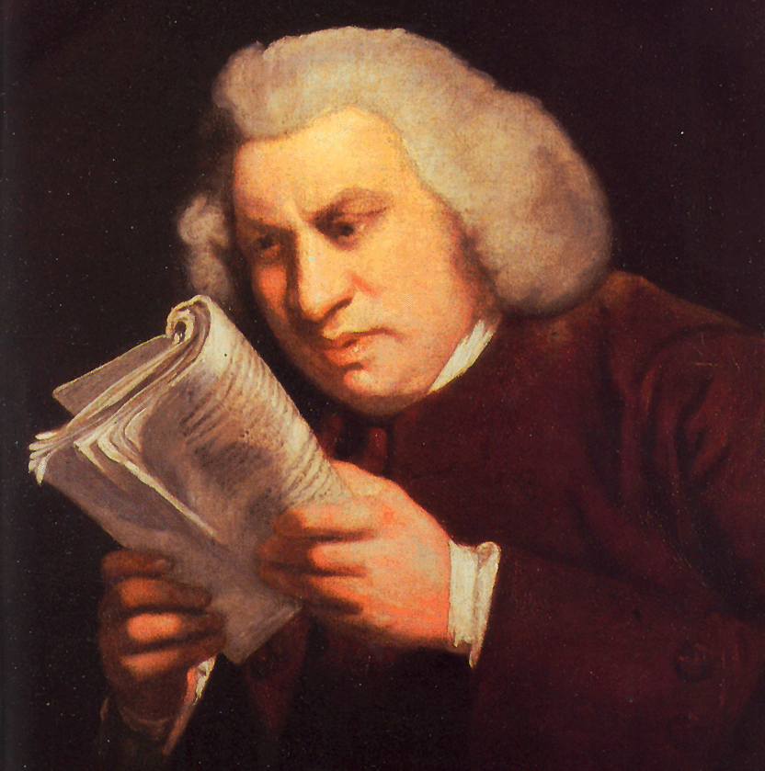

Slide 120
?????

Slide 121
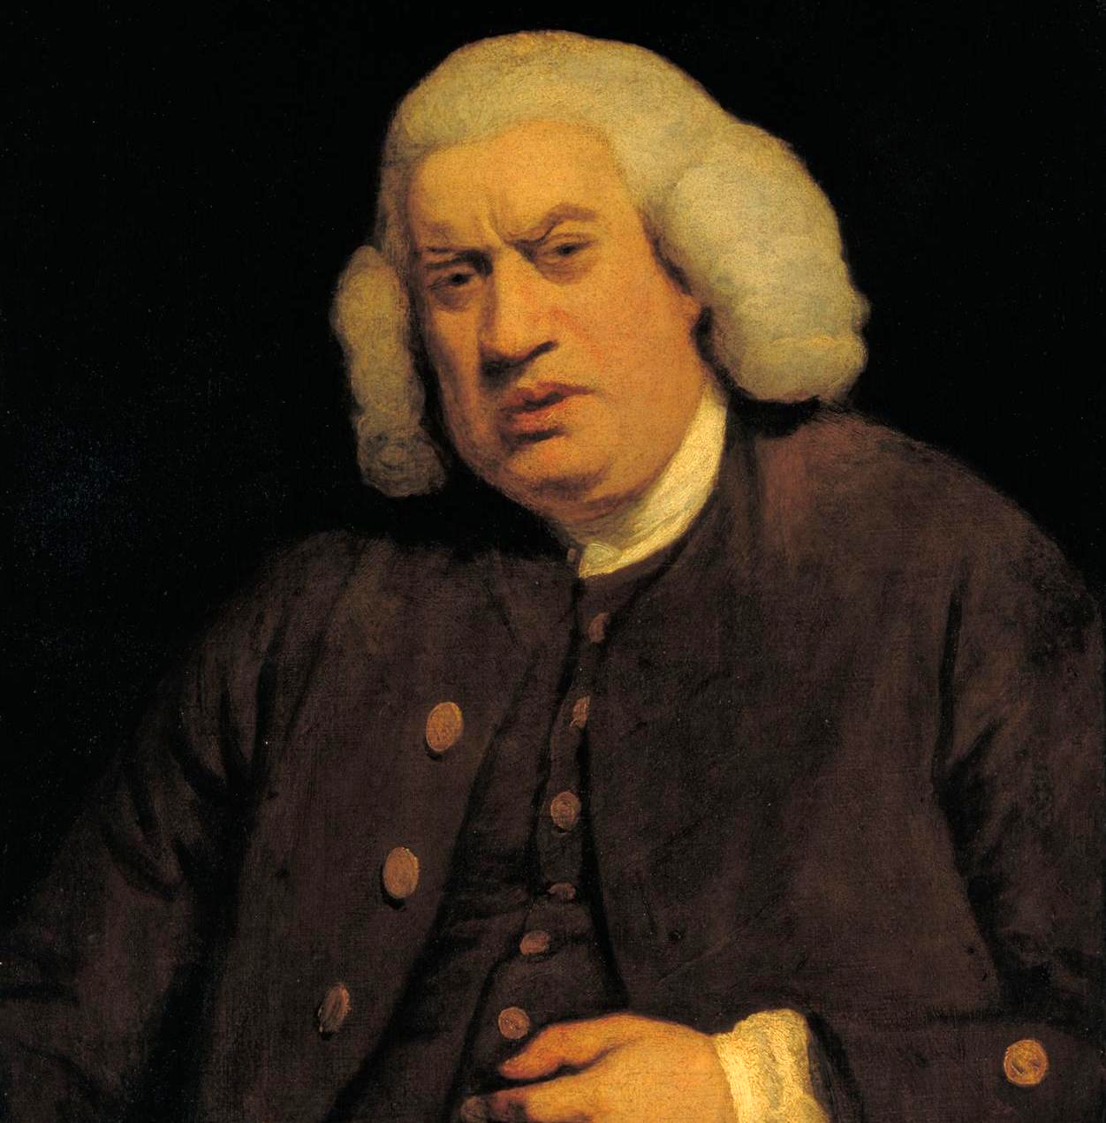

Slide 122
function formatPathStr(config, preferences, defaultPath, alternativePath, reroute, cb) {
var path;
// We need to check if they want
if(config && config.path && !config.path.match(/tmp/) && (defaultPath || alternativePath)) {
if(preferences.reroute && alternativePath) {
path = alternativePath + '/zone2/' + config.path;
return reroute(path); //Promise
}
if(!preferences.reroute && alternativePath) {
if(!alternativePath.match(/user/)) {
if(preferences.send) {
path = alternativePath + '/zone3' + config.path;
cb();
return;
}
path = alternativePath + '/zone2' + config.path;
}
}
// This goes on and on
}
return config.name + '/zone5/' + config.path;
}

Slide 123
function formatPathStr(config, preferences, defaultPath, alternativePath, reroute, cb) {
var path;
// We need to check if they want
if(config && config.path && !config.path.match(/tmp/) && (defaultPath || alternativePath)) {
if(preferences.reroute && alternativePath) {
path = alternativePath + '/zone2/' + config.path;
return reroute(path); //Promise
}
if(!preferences.reroute && alternativePath) {
if(!alternativePath.match(/user/)) {
if(preferences.send) {
path = alternativePath + '/zone3' + config.path;
cb();
return;
}
path = alternativePath + '/zone2' + config.path;
}
}
// This goes on and on
}
return config.name + '/zone5/' + config.path;
}
Smelly Code

Slide 124
function formatPathStr(config, preferences, defaultPath, alternativePath, reroute, cb) {
var path;
// We need to check if they want
if(config && config.path && !config.path.match(/tmp/) && (defaultPath || alternativePath)) {
if(preferences.reroute && alternativePath) {
path = alternativePath + '/zone2/' + config.path;
return reroute(path); //Promise
}
if(!preferences.reroute && alternativePath) {
if(!alternativePath.match(/user/)) {
if(preferences.send) {
path = alternativePath + '/zone3' + config.path;
cb();
return;
}
path = alternativePath + '/zone2' + config.path;
}
}
// This goes on and on
}
return config.name + '/zone5/' + config.path;
}
Long parameter list
Complex conditional blocks
Differing return statements
Uncommunicative name

Slide 125
function formatPathStr(config, preferences, defaultPath, alternativePath, reroute, cb) {
var path;
// We need to check if they want
if(config && config.path && !config.path.match(/tmp/) && (defaultPath || alternativePath)) {
if(preferences.reroute && alternativePath) {
path = alternativePath + '/zone2/' + config.path;
return reroute(path); //Promise
}
if(!preferences.reroute && alternativePath) {
if(!alternativePath.match(/user/)) {
if(preferences.send) {
path = alternativePath + '/zone3' + config.path;
cb();
return;
}
path = alternativePath + '/zone2' + config.path;
}
}
// This goes on and on
}
return config.name + '/zone5/' + config.path;
}
Coding Horror Code Smells

Slide 126
function formatPathStr(config, preferences, defaultPath, alternativePath, reroute, cb) {
var path;
// We need to check if they want
if(config && config.path && !config.path.match(/tmp/) && (defaultPath || alternativePath)) {
if(preferences.reroute && alternativePath) {
path = alternativePath + '/zone2/' + config.path;
return reroute(path); //Promise
}
if(!preferences.reroute && alternativePath) {
if(!alternativePath.match(/user/)) {
if(preferences.send) {
path = alternativePath + '/zone3' + config.path;
cb();
return;
}
path = alternativePath + '/zone2' + config.path;
}
}
// This goes on and on
}
return config.name + '/zone5/' + config.path;
}
Don’t memorize smells.

Slide 127
function formatPathStr(config, preferences, defaultPath, alternativePath, reroute, cb) {
var path;
// We need to check if they want
if(config && config.path && !config.path.match(/tmp/) && (defaultPath || alternativePath)) {
if(preferences.reroute && alternativePath) {
path = alternativePath + '/zone2/' + config.path;
return reroute(path); //Promise
}
if(!preferences.reroute && alternativePath) {
if(!alternativePath.match(/user/)) {
if(preferences.send) {
path = alternativePath + '/zone3' + config.path;
cb();
return;
}
path = alternativePath + '/zone2' + config.path;
}
}
// This goes on and on
}
return config.name + '/zone5/' + config.path;
}
Trust yourself

Slide 129
function createThunkMiddleware(extraArgument) {
return ({ dispatch, getState }) => next => action => {
if (typeof action === 'function') {
return action(dispatch, getState, extraArgument);
}
return next(action);
};
}
const thunk = createThunkMiddleware();
thunk.withExtraArgument = createThunkMiddleware;
export default thunk;

Slide 130


Slide 131
Build Intuition and Refactoring

Slide 132
Build Intuition and Refactoring
Pop Quiz

Slide 133
Get an array of unique items
Determines if a string starts with an uppercase letter
Calculate the area of a circle given radius

Slide 134
function getUniqueItems(arr) {
let unique = [];
for(let item of arr) {
if(!unique.includes(item)) {
unique.push(item);
}
}
return unique;
}

Slide 135
Cultivate Disatisfaction
function getUniqueItems(arr) {
let unique = [];
for(let item of arr) {
if(!unique.includes(item)) {
unique.push(item);
}
}
return unique;
}

Slide 136
You can look up solved problems
function getUniqueItems(arr) {
let unique = [];
for(let item of arr) {
if(!unique.includes(item)) {
unique.push(item);
}
}
return unique;
}

Slide 137
function getUniqueItems(arr) {
return arr.reduce((unique, item) => {
return unique.includes(item) ? unique : [...unique, item];
}, [])
}

Slide 138
Iterate Over Ideas
function getUniqueItems(arr) {
return arr.reduce((unique, item) => {
return unique.includes(item) ? unique : [...unique, item];
}, [])
}

Slide 139
function getUniqueItems(items) {
return [...new Set(items)];
}

Slide 140
Test
function getUniqueItems(items) {
return [...new Set(items)];
}

Slide 141
Tools, Principles, Patterns

Slide 142
Why do things exist

Slide 143

Why do things exist

Slide 144
Why do things exist
const x = ['a', 'b', 'c'];
...x
// 'a', 'b', 'c'
Notes:
This is very hard if you have a strong understanding of another framework.

Slide 145
Solve the problem
const x = ['a', 'b', 'c'];
x.push('d');
x;
['a', 'b', 'c', 'd'];
Notes:
This is very hard if you have a strong understanding of another framework.

Slide 146
What is the [X] way to solve the problem?
const x = ['a', 'b', 'c'];
x.push('d');
x;
['a', 'b', 'c', 'd'];
Notes:
This is very hard if you have a strong understanding of another framework.

Slide 147
What is the JavaScript way to solve the problem?
const x = ['a', 'b', 'c'];
x.push('d');
x;
['a', 'b', 'c', 'd'];
Notes:
This is very hard if you have a strong understanding of another framework.

Slide 148
What is the JavaScript way to solve the problem?
mutation
const x = ['a', 'b', 'c'];
x.push('d');
x;
['a', 'b', 'c', 'd'];
Notes:
This is very hard if you have a strong understanding of another framework.

Slide 149
What is the JavaScript way to solve the problem?
const x = ['a', 'b', 'c'];
const y = [...x, 'd'];
y;
['a', 'b', 'c', 'd'];
x;
['a', 'b', 'c'];
Notes:
This is very hard if you have a strong understanding of another framework.

Slide 150
What is the JavaScript way to solve the problem?
const x = ['a', 'a', 'b', 'c'];
const copyX = [...x];
const combined = [...x, ...y];
const unique = [...new Set(x)];
Notes:
This is very hard if you have a strong understanding of another framework.

Slide 151
What is the JavaScript way to solve the problem?
No Mutations
const x = ['a', 'a', 'b', 'c'];
const copyX = [...x];
const combined = [...x, ...y];
const unique = [...new Set(x)];
Notes:
This is very hard if you have a strong understanding of another framework.

Slide 152
What is the Python way to solve the problem?
Notes:
This is very hard if you have a strong understanding of another framework.

Slide 153
Suspicious Python Devs
Notes:
This is very hard if you have a strong understanding of another framework.

Slide 154
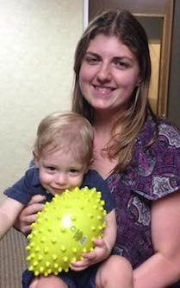
Suspicious Python Devs
Notes:
This is very hard if you have a strong understanding of another framework.

Slide 155
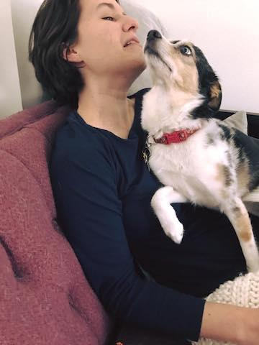
Suspicious Python Devs
Notes:
This is very hard if you have a strong understanding of another framework.

Slide 156
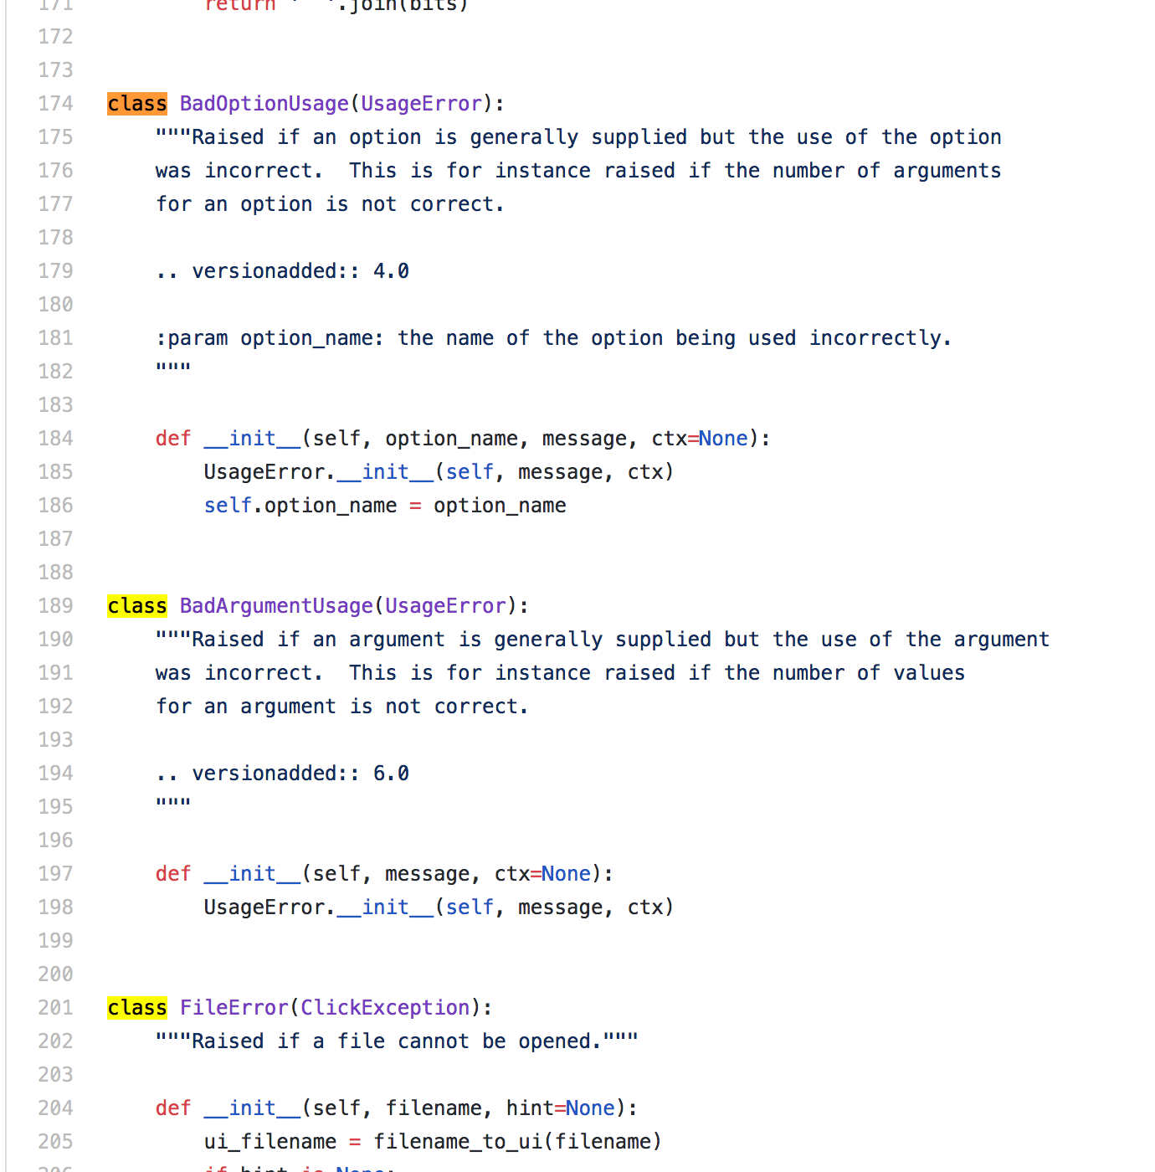
Notes:
This is very hard if you have a strong understanding of another framework.

Slide 157
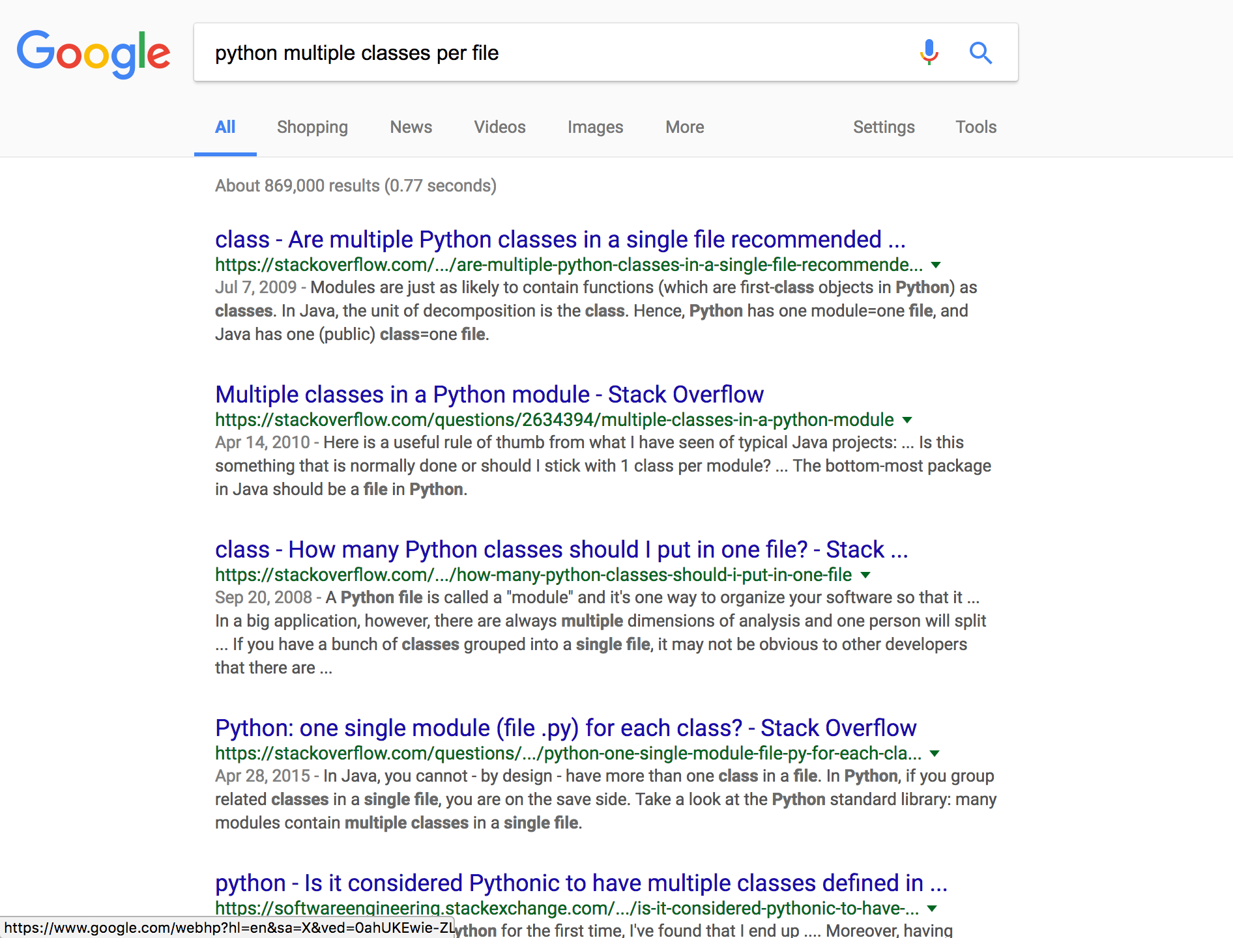
Notes:
This is very hard if you have a strong understanding of another framework.

Slide 158
Learn Principles

Slide 159
Learn Principles
… BUT they should really be there to solidify what you’ve been seeing

Slide 160
Learn Principles
This was the book that showed me there were names for so many patterns that I’d discovered purely through fumbling around with my own code.
-- Rebecca Murphey on JavaScript Patterns

Slide 161
Learn Principles
… they are there to help communicate

Slide 162
Learn Principles
Experience without theory is blind, but theory without experience is mere intellectual play -- Immanuel Kant

Slide 163
Learn Principles
… run everything through your hands or eyes

Slide 164
Learn Principles
… Before I created Rails, I redrew many of the diagrams in OmniGraffle for Martin Fowler because I liked the book so much
-- David on Patterns of Enterprise Architecture

Slide 165
Learn Principles
…The trick to reading this book is to carefully read through every single refactoring pattern and then try to apply it on your code base (you don’t have to commit if it doesn’t fix things). You can’t just blow through it or you won’t really learn it.
-- David on Refactoring

Slide 166
Learn Principles
✔ Algorithms
✔ Mutations/Side Effects
✔ Patterns (Gang of Four)
✔ SOLID

Slide 169
See Abstractions Across Projects

Slide 170
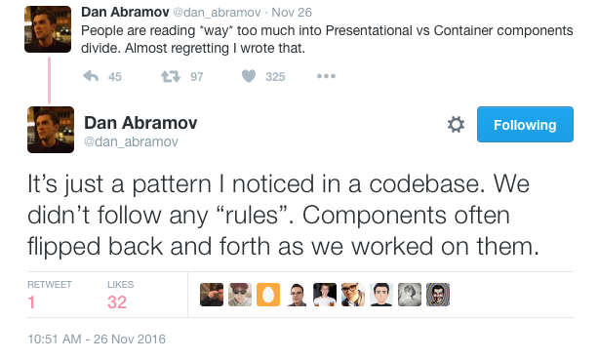

Slide 171
“We have included only designs that have been applied more than once in different systems… Most … have never been documented before”
-- Gang of Four Design Patterns

Slide 172
“How many times have you had design déjà vu -- that feeling that you’ve solved a problem before but not knowing exactly where or how?

Slide 174
Foo.js

Slide 175
Foo.js
-- src
-- components
-- button.js
-- link.js
-- footer.js
-- util
-- colors

Slide 176
Foo.js
-- src
-- components
-- button.js
-- link.js
-- footer.js
-- util
-- colors

Slide 177
Reusable

Slide 178
Rule of three:
“The first time you do something, you just do it. The second time you do something similar, you wince at the duplication, but you do the duplicate thing anyway. Third you do something similar, you refactor.”
-- Martin Fowler Refactoring

Slide 179
Decoupled

Slide 180


Slide 181
import fetch from 'isomorphic-fetch';
function updateInventory(store) {
return fetch(`http://foo.com/inventory?key=abc&name=${store}`)
.then(response => response.json())
.then((result) => {
const count = result.inventory.toLocaleString();
return `Inventory is ${count}.`;
});
}
export default updateInventory;

Slide 182
import fetch from 'isomorphic-fetch';
function updateInventory(store) {
return fetch(`http://foo.com/inventory?key=abc&name=${store}`)
.then(response => response.json())
.then((result) => {
const count = result.inventory.toLocaleString();
return `Inventory is ${count}.`;
});
}
export default updateInventory;
Tightly coupled to api

Slide 183
import expect from 'expect';
import nock from 'nock';
import updateInventory from './coupled1';
describe('inventory update', () => {
it('should update inventory', () => {
nock('http://foo.com')
.get('/inventory')
.query({
key: 'abc',
name: 'bar',
})
.reply(200, { inventory: 1350 });
return updateInventory('bar').then((result) => {
expect(result).toEqual('Inventory is 1,350.');
});
});
});

Slide 184
import expect from 'expect';
import nock from 'nock';
import updateInventory from './coupled1';
describe('inventory update', () => {
it('should update inventory', () => {
nock('http://foo.com')
.get('/inventory')
.query({
key: 'abc',
name: 'bar',
})
.reply(200, { inventory: 1350 });
return updateInventory('bar').then((result) => {
expect(result).toEqual('Inventory is 1,350.');
});
});
});
Hijack the http request

Slide 185
import { getInventory } from './inventoryManager';
function updateInventory(store) {
return getInventory(store)
.then((result) => {
const count = result.inventory.toLocaleString();
return `Inventory is ${count}.`;
});
}
export default updateInventory;

Slide 186
import { getInventory } from './inventoryManager';
function updateInventory(store) {
return getInventory(store)
.then((result) => {
const count = result.inventory.toLocaleString();
return `Inventory is ${count}.`;
});
}
export default updateInventory;
Endpoint removed

Slide 187
import expect from 'expect';
import sinon from 'sinon';
import updateInventory from './coupled';
import * as i from './inventoryManager';
describe('inventory update', () => {
beforeEach(() => {
const fetchInventory = new Promise(resolve => resolve({ inventory: 1350 }));
sinon.stub(i, 'getInventory').returns(fetchInventory);
});
afterEach(() => {
i.getInventory.restore();
});
it('should update inventory', () => updateInventory('bar').then((result) => {
expect(result).toEqual('Inventory is 1,350.');
}));
});

Slide 188
import expect from 'expect';
import sinon from 'sinon';
import updateInventory from './coupled';
import * as i from './inventoryManager';
describe('inventory update', () => {
beforeEach(() => {
const fetchInventory = new Promise(resolve => resolve({ inventory: 1350 }));
sinon.stub(i, 'getInventory').returns(fetchInventory);
});
afterEach(() => {
i.getInventory.restore();
});
it('should update inventory', () => updateInventory('bar').then((result) => {
expect(result).toEqual('Inventory is 1,350.');
}));
});
Mocking

Slide 189
function updateInventory(store, fetchInventory) {
return fetchInventory
.then((result) => {
const count = result.inventory.toLocaleString();
return `Inventory is ${count}.`;
});
}
export default updateInventory;

Slide 190
function updateInventory(store, fetchInventory) {
return fetchInventory
.then((result) => {
const count = result.inventory.toLocaleString();
return `Inventory is ${count}.`;
});
}
export default updateInventory;
Inject everything

Slide 191
import expect from 'expect';
import updateInventory from './coupled3';
describe('inventory update', () => {
it('should update inventory', () => {
const fetchInventory = new Promise(resolve => {
resolve({ inventory: 1350 })
});
return updateInventory('bar', fetchInventory).then((result) => {
expect(result).toEqual('Inventory is 1,350.');
});
});
});

Slide 193
Creatively Apply Ideas

Slide 194
Master the why of your language first

Slide 195
Redux

Slide 196
Redux
Dan Abramov
Wanted to speak at a JS conference in Europe.

Slide 197
Redux
Dan Abramov
Applied Elm architecture in React

Slide 198
Elm
UI
HTML
message
View
Update
model

Slide 199
Redux
UI
HTML
action
View
Reducer
state

Slide 200
JavaScript
Brendan Eich was recruited to make Scheme into a scripting language. Netscape partner Sun Systems demanded it be similar to Java.
Brendan Eich wrote it in 10 days.

Slide 201
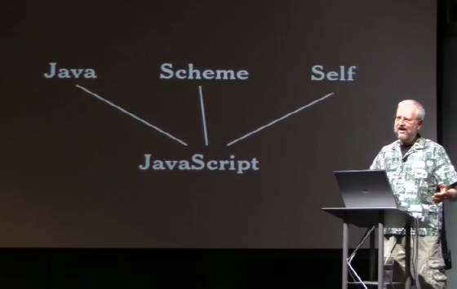

Slide 202
Linux
Linus Torvalds wanted to try out a new chip.

Slide 203

Linux
I'm doing a (free) operating system (just a hobby, won't be big and professional like gnu)... This has been brewing since april, and is starting to get ready. I'd like any feedback on things people like/dislike in minix, as my OS resembles it somewhat (same physical layout of the file-system...

Slide 204
Why
Bored.
Curious.
Dictated.

Slide 205
Why
They understood their inspirational material enough to take what they needed.

Slide 206
 | Style | Feedback | Flow
 | Beautiful | Refactor | Patterns
 | Abstract | Reusable | Creativity

Slide 207
Why?

Slide 208
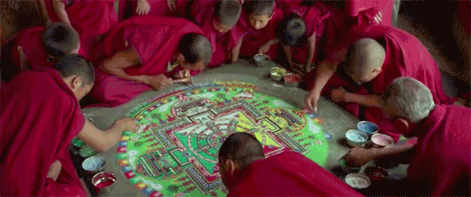
Joe Morgan
@joesmorgan | thejoemorgan.com
Notes:
Everything we do is going away
If you don’t care about craftsmanship its like your digging a whole in the desert. There’s not satisfaction. If you focus, though, on laying every grain of sand perfectly. You’ll have something beautiful. Something perfect.
It’s those tiny moments that make up something bigger. If you write an ugly function, it doesn’t seem like much, but it takes away.
Craft is about doing the best for it’s own sake. Even if the product leaves, that remains.

